Slide 1
Short Introduction on Networks Internet - Basic Search
COE 201- Computer Proficiency
Mr. Ahmad Al Kawam

Slide 2
Outline
Internet Basics
Web Browser
IP Address
DNS
Protocols
Firewall
Proxy
Search Engines
Search Optimization

Slide 3
Internet Basics
URL
Uniform Resource Locator
Unique address of any web document/page
Also called domain name or internet address
Is entered in the address bar in your browser
To Browse
Or to surf
follow links in a page/ discover websites and their content.
Usually used like "I browse some sites" or "I'm surfing on the net".
Downloads
A download is a file you have transferred from another computer to your computer over the internet.
Links
Aka Hyperlink
Links one electronic document to another

Slide 4
Web Browser
Aka browser
Makes the content on the internet viewable
Converts the data coming from the internet to the graphical interface you see.
Displays all elements of a website at their designated positions.
Example:
Internet Explorer (IE)
Mozilla Firefox
Google Chrome
Opera
Safari

Slide 5
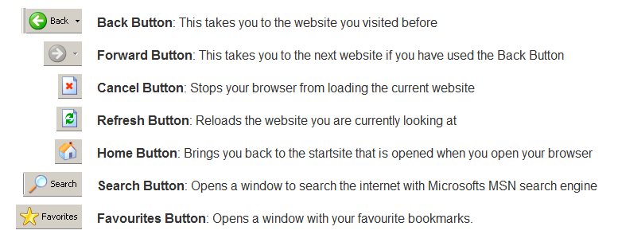
Web Browser
Browser’s basic components:
Address Bar:
Most important part of your browser.
You can enter all domain names you want to visit in it.

Slide 6
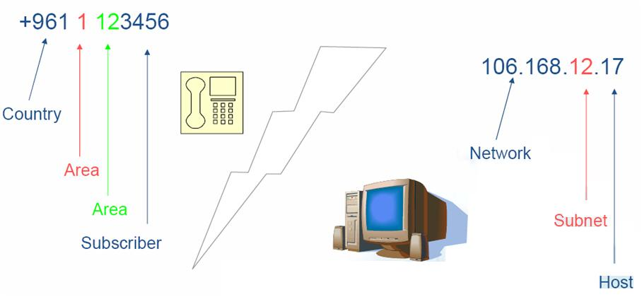
The IP address

Slide 7
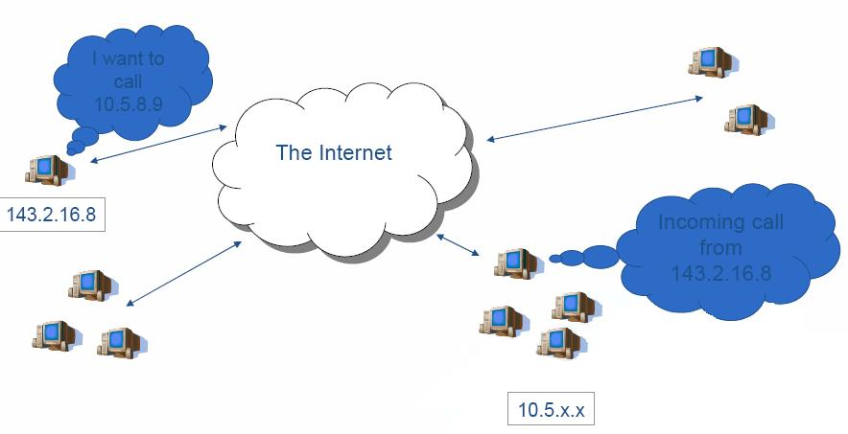
PC to PC communication

Slide 8
Domain Name
Part of URL, between “www.” and the first “/”
In case of http://www.google.com/search... , “google.com” is the domain name.
has a suffix → indicates for what purpose this domain is used.
Every country has also a specific suffix.
Because the Internet is based on IP addresses, not domain names, every Web server requires a Domain Name System (DNS) server to translate domain names into IP addresses.

Slide 9
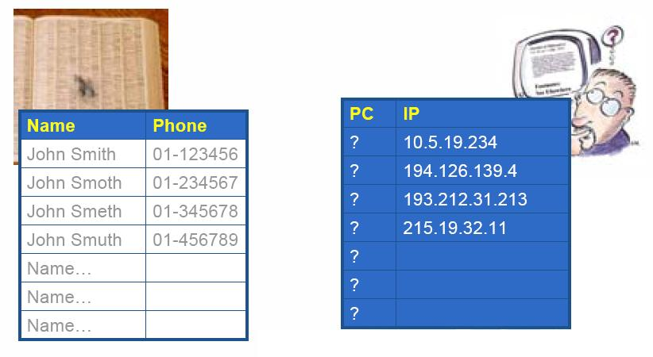
The DNS
Notes:
Domain Name System: A database system that translates an IP address into a domain name. For example, a numeric IP address like 207.219.116.4 is converted into netlingo.com.

Slide 10
The DNS
Domain Name System or Service or Server (DNS)
DNS | Use
.com | Commercial (business)
.lb | Lebanese websites
.us | U.S. websites
.info | Informational websites
.org | Organization
.edu | Educational organization
.gov | Government Agency

Slide 11
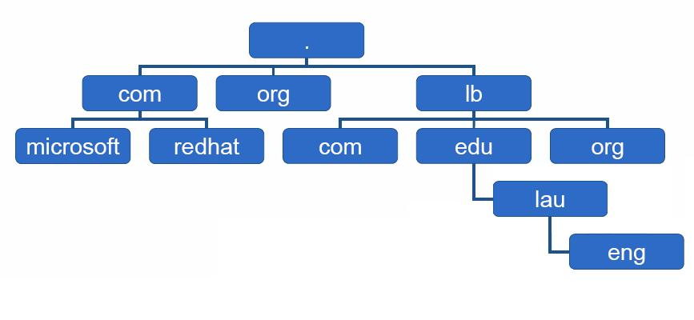
The DNS (continued)
Services

Slide 12
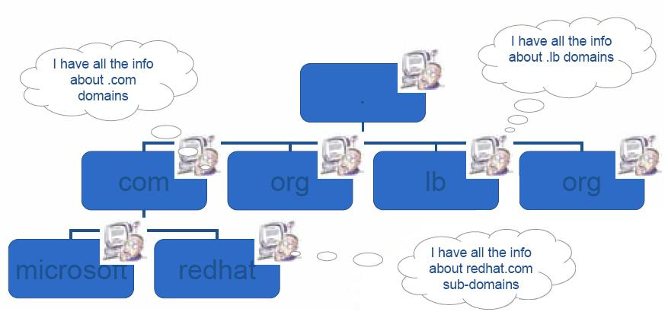
The DNS (continued)

Slide 13
Protocols

Slide 14
Protocols (Continued)
Protocols are “languages” that computers use to communicate with each other.
A dialed computer should be able to talk the dialing computer’s protocol.
Protocol = Language

Slide 15
Typical Protocols
Protocol Name | Usage
HTTP | Browsing web pages
FTP | Downloading/ Uploading files
SMTP | Sending e-mail
POP3 | Receiving e-mail
Telnet | Remote access
IRC | Chatting

Slide 16
Question!
What happens from the moment you type
an address in your browser window till the
moment the page appears?

Slide 17
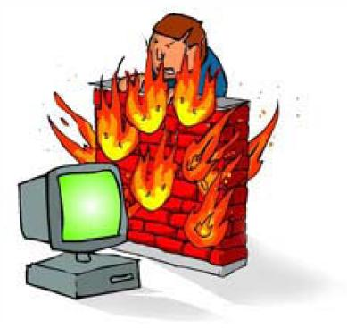
The Firewall
Its mission:
Protects your computer(s) or
network from the outside attacks.

Slide 18
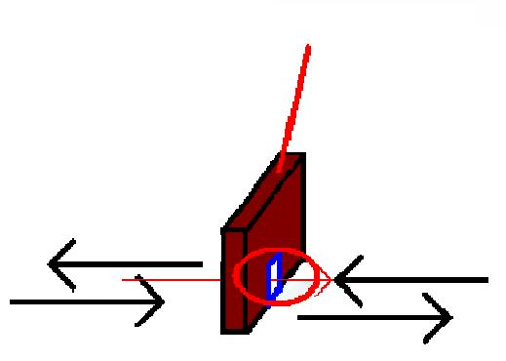
The Proxy
With a firewall, no one can get in
BUT NO ONE can get out!!!
Solution:
The proxy is a door in the firewall
Firewall
Inside
Outside

Slide 19
Search Engines
Three types of search engines:
Human-powered
Crawler Based
Hybrid
NOTE:
No search engine has more than
40% of the total websites available
online!!

Slide 20
Search Engines (continued)
Human -powered:
Depends on humans for its listings
You submit a short description to the directory for your entire site
A search looks for matches only in the descriptions submitted.
Changing your web pages has no effect on your listing
Crawler-Based:
Such as Google
They "crawl" or "spider" the web
create their listings automatically, then people search through what they have found.
you change your web pages they find these changes change your listing.

Slide 21
Search Engines (continued)
"Hybrid Search Engines" Or Mixed Results
Search engines used to either present:
crawler-based results
human-powered listings.
Today……
both types of results are presented.

Slide 22
How to Search?
“+”
To search for two or more terms on the same page.
Type “+” between the terms
Refers to AND
Example: sun + heat
“OR”
To search for either of two (or more) terms on the same page
Type the word OR between the terms
Example: sun OR heat
“-”:
To search for pages that include the first term and not the second
Type “-” between the terms
Example: sun -heat

Slide 23
How to Search?(continued)
“”
To search for an exact phrase
Enclose the phrase in quotation marks
Example: “sun heat effects”
( )
To group parts of your search
Enclose them in parenthesis
Example: sun + (heat OR burn)
This will return pages with both the words sun and heat or both the words sun and burn.
*
To search for various forms of a word
Add an asterisk to the end of the word
Example: sun*
This returns pages with the words sun, sunglass, sunburn, sunrise…

Slide 24
Optimizing your search
Let’s try some Google queries:
Keywords | Results
chocolate + cake | 93,700,000
chocolate OR cake | 1,350,000,000
"chocolate cake" | 25,200,000
"cake chocolate" | 2,190,000

